Slide 1
House Price Prediction
Group 17
Fall,21

Slide 2
Executive summary
“Housing Market” which comes under the real estate business is one of the most generated revenue in United States and it is one of the broader markets which offers employment to multiple resources(people) in multiple sectors.
The house “sales” are impacted by the substantial increase or decrease in the housing prices, as the sales depends on the prices set up for the floor plans thereby impacting the economic growth.
In this project, we are predicting the “Sale Price” of the houses based on the previous sales data. We have run total 3 models(Linear Regression, Decision Tree , Auto Neural Network) and inspected the best one.

Slide 3
Project motivation/background
Everyone dreams to have a place of their own to live in. When we ask about their dream house, they presumably will not begin with the comparative distance from the transportation options(bus, rail stations)or the basement and ceiling height. But this dataset proves that there is much more that influences price negotiations than just the number of bedrooms/bathrooms , house area , quality of the fence etc.
Also, if anyone wants to invest in the properties, house price forecasting of the future serves better to plan their finances.
The purpose of this research is to identify probable elements that will influence pricing negotiations. When it comes to selling a home, getting the correct price is crucial. Increasing sales is a key aspect of market expansion, which in turn contributes to generating good revenue impacting the nation's economic growth.

Slide 4
Objective
Aim : To apply the knowledge of Data Mining to the real-life example “Housing Market” and create a model with the data to predict the “Sale price” of the house.
Objectives :
To build the best model that predicts the price of houses in the market.
To determine the variables which will have a significant impact on the house price prediction.
For this, we need to obtain the records of home sales in the past, explore the data, sample the data and model it in order to predict the right estimated price of the house.

Slide 5
Problem Statement within Business Situation
There are numerous aspects that affect house prices. We can categorize these factors into three main divisions such as physical setting, approach(concept) and locale. Physical settings are landscape and design of a house that can be noticed, inclusive of the house size, the total number of bedrooms/bathrooms, the spacing of kitchen and pantry, garage unit, the garden area, the total area of the land, year built etc.[5], while the concept is an interpretation offered by developers who can attract capable buyers.
Example: A minimalist home which has green environment and well-organized spaces in minimal area where every part of the house is occupied, and the space is not wasted.
Since there are multiple factors affecting the house prices, every house has its own plan and concept, but the materials and the quality differs depending on external factors like area and land. The question is if changing the components of the house inclines or declines the sales price of the house?

Slide 6
Data Description
Our data used in this project is secondhand data obtained from “Kaggle.com”.
The data is non-statistical to record detailed data of homes which provides information such as the year built, street , area , land slope ,number of bedrooms and bathrooms , garage information ,style of the house, sale condition ,material used, type of roof , type of foundation , central air conditioning, heating , paved drive , etc.
The dataset contains 80 Independent variables with 1260 observations that are either interval or nominal data type. The target variable used for the prediction is “Sale Price” which is a numeric data type also called as the dependent variable.

Slide 7
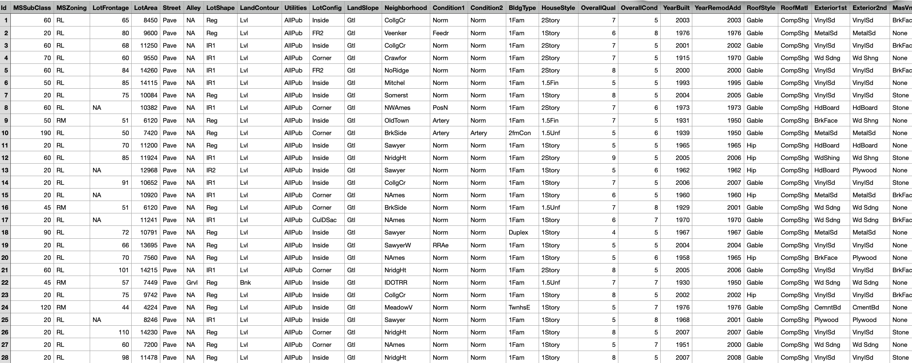
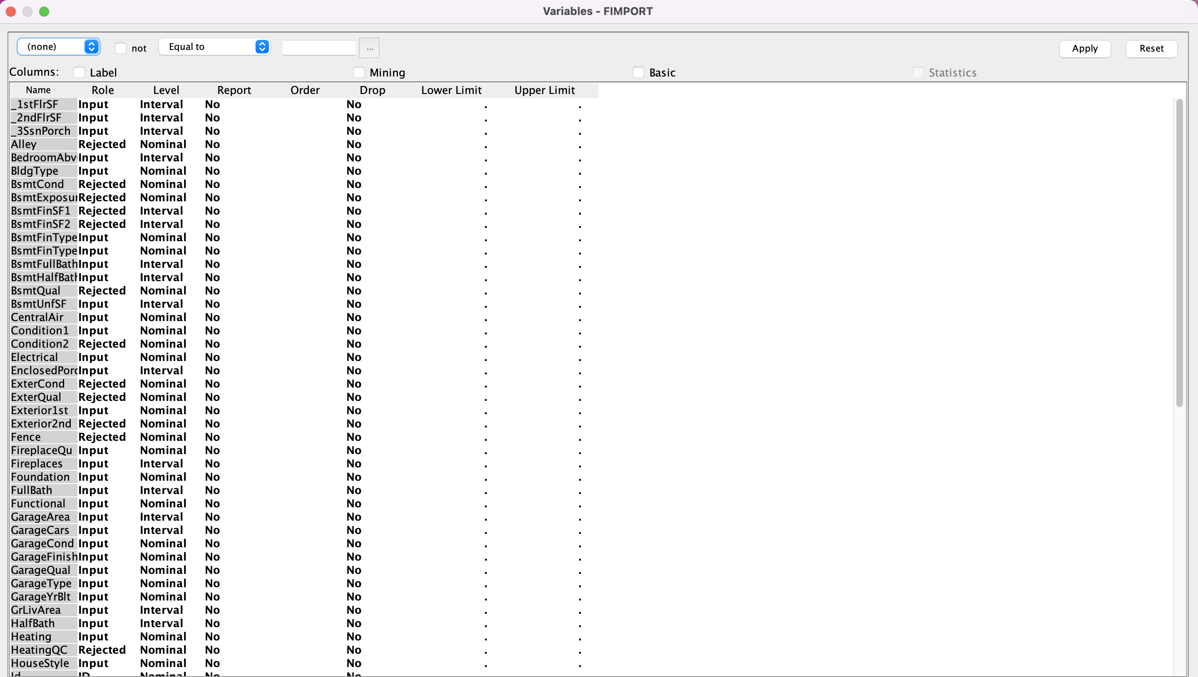
Data description
We're working with the data in the csv file. Our information includes the data of multiple houses, describing each feature that goes into calculating the house's price.
We are considering the “Sale Price” as our target, and that sale price is what we are finding in our project.
The input variables are the ones which plays prominent role in determining the price of the property.
The training data will be used to teach our models based on the variables we select as input.

Slide 8
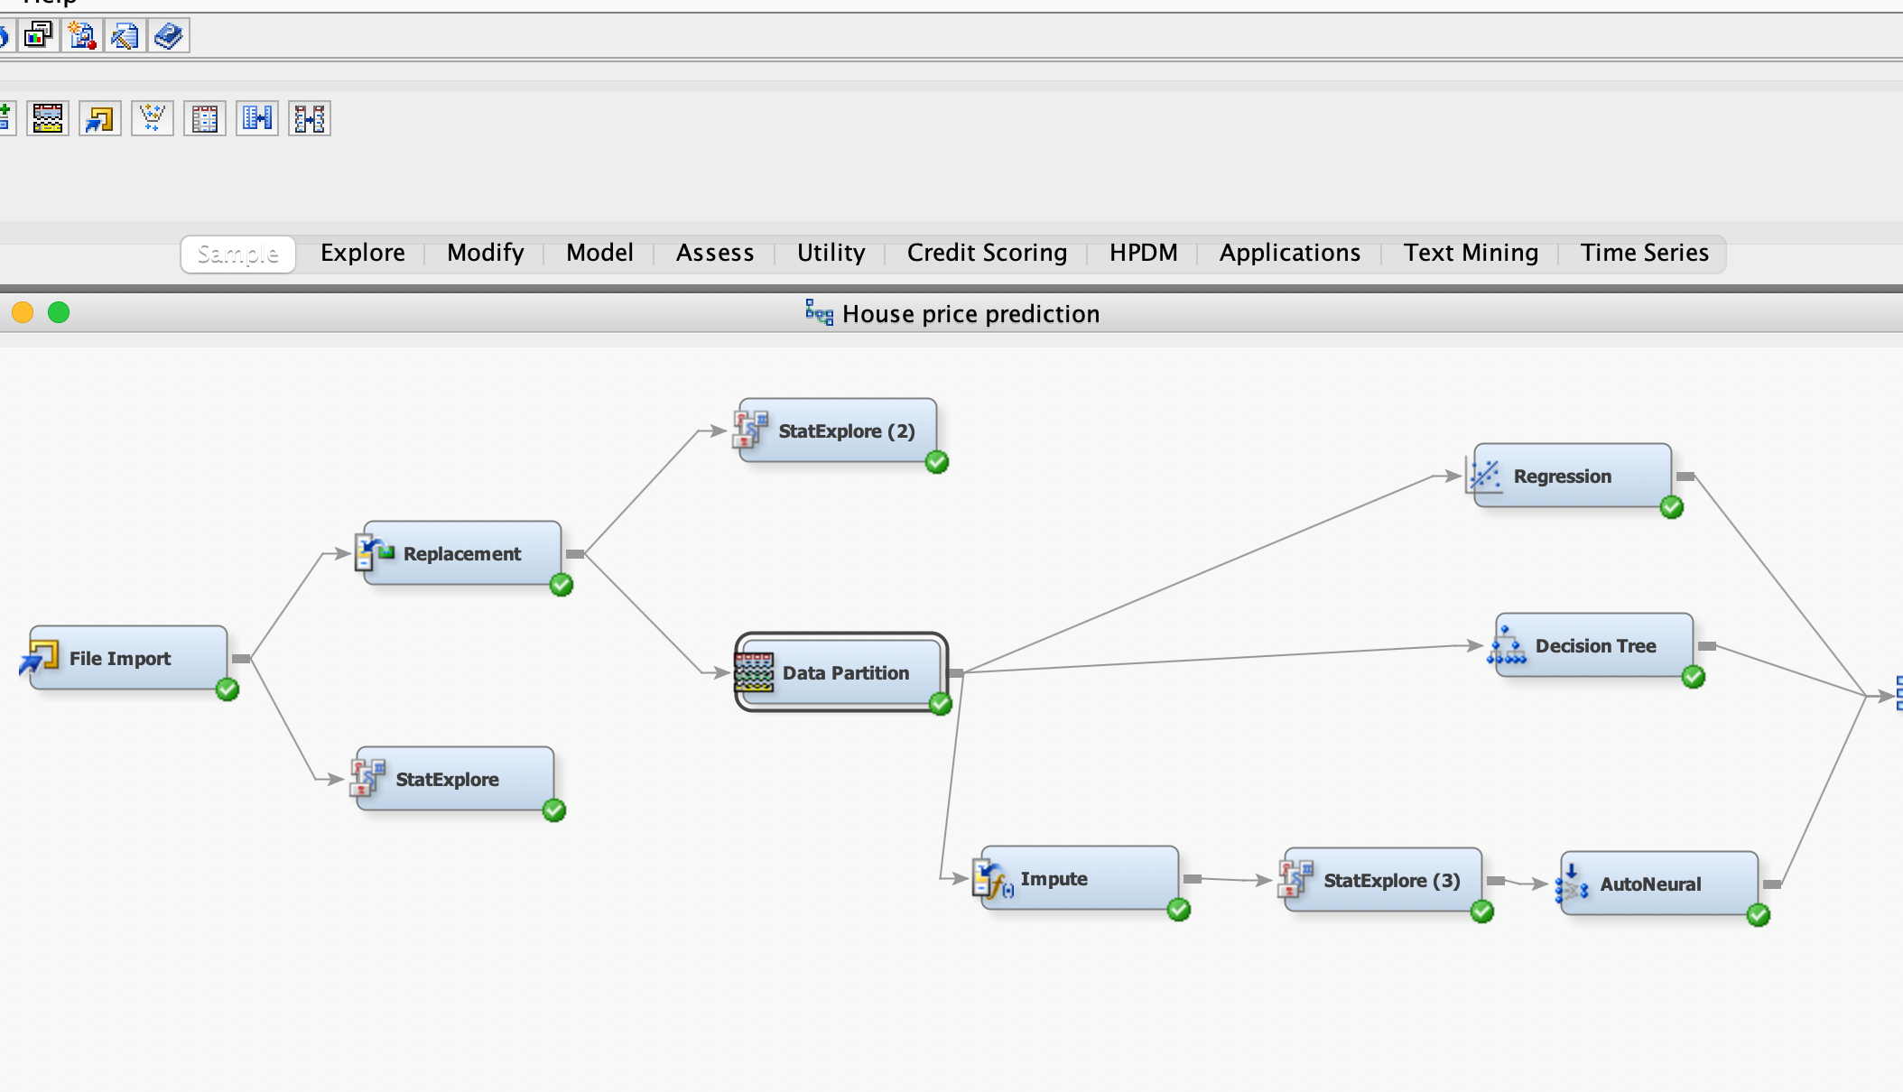
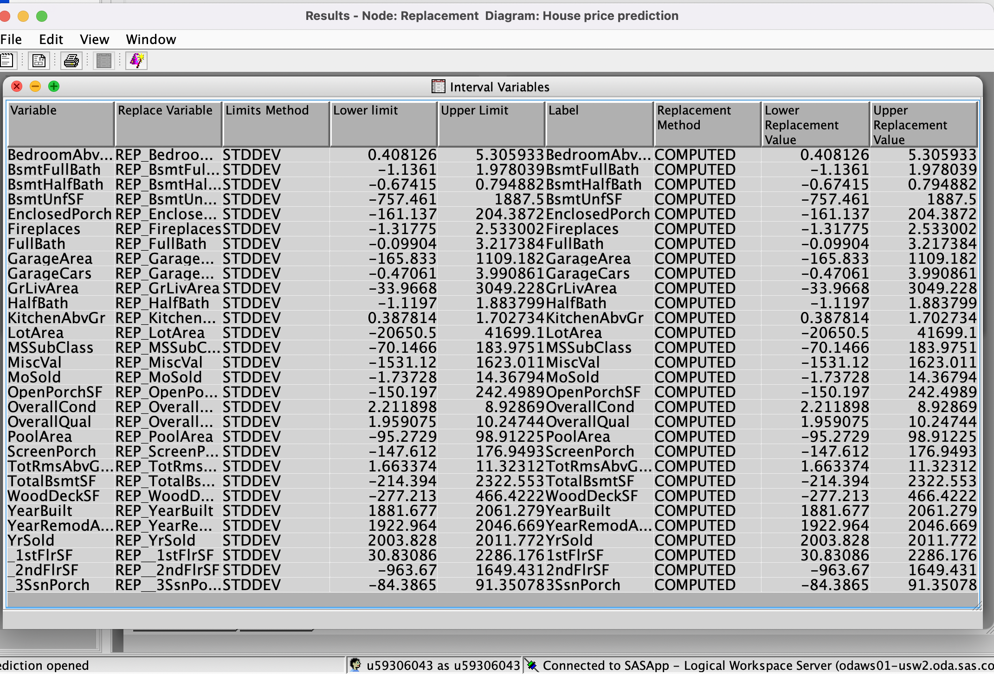
Data preparation activities
Data Preparation activities include gathering , assessing , cleansing , transforming , storing data[6].
Gathering Data : We have used “Kaggle.com” for our dataset which is a secondhand data.
Assessing Data : We have set few values to Rejected and rest as inputs , giving “Sale Price” as target.
StatExplore – we have used this node in SAS to explore the data using statistical output.
Cleaning the data
Replacement Node – this is used specifically for the replacement of missing class and interval variables within the data set based on specific values. N/A or missing values can cause errors in the model, so it is better to get rid of them and avoid such N/A values to get efficient output. Here, in our project, the dataset with the missing values are replaced with the “default” value and the possible effect of missing values on the target variable is reduced

Slide 9
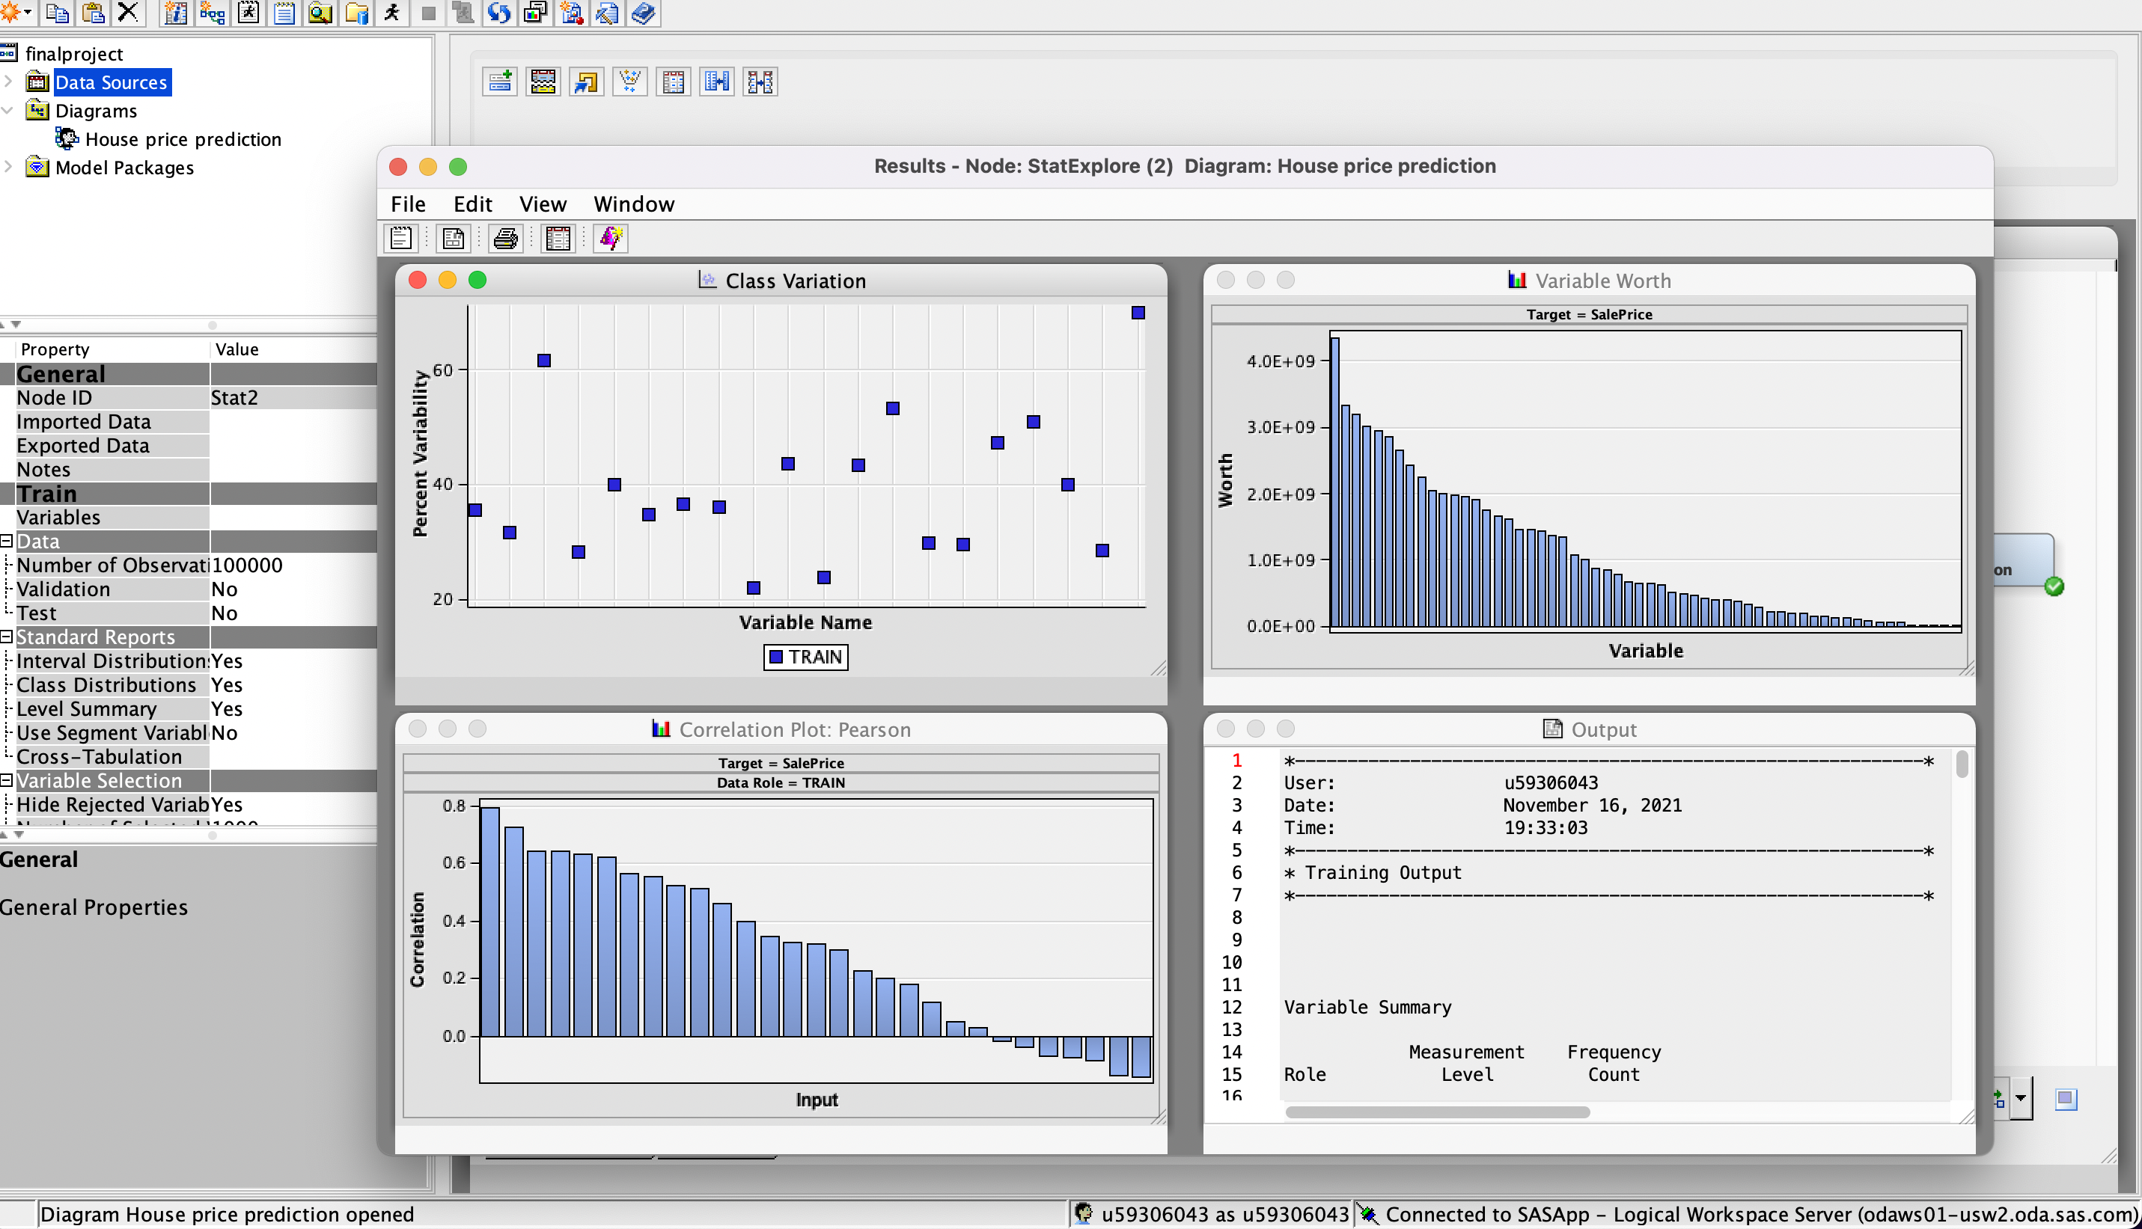
Results
The second stat explore node analyzes the specifics of the various data. We can find information about the input variables and the probable effect on the target variable by statistical exploring of the input variables after replacing the missing values with the help of replacement node.
The overview of results gives us the available options for predicting such as regression, neural networks, etc.

Slide 10
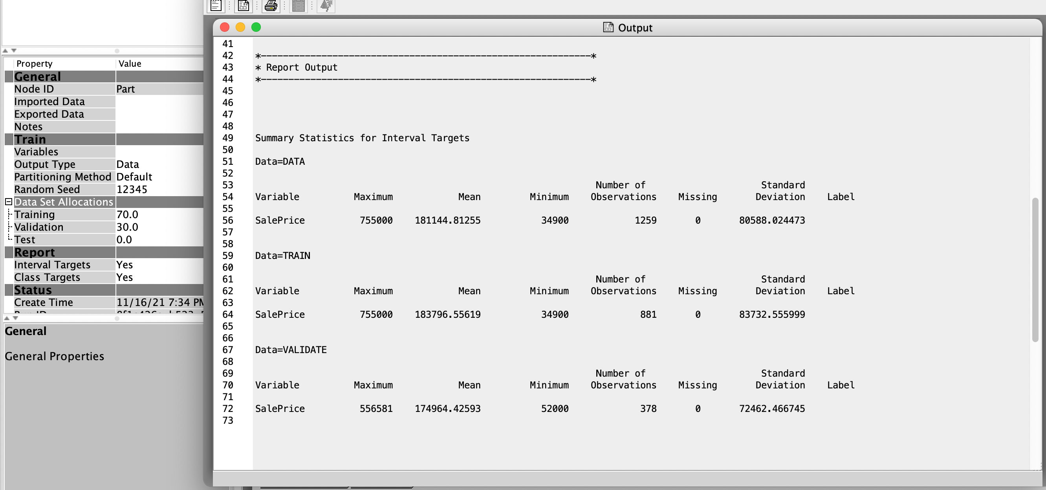
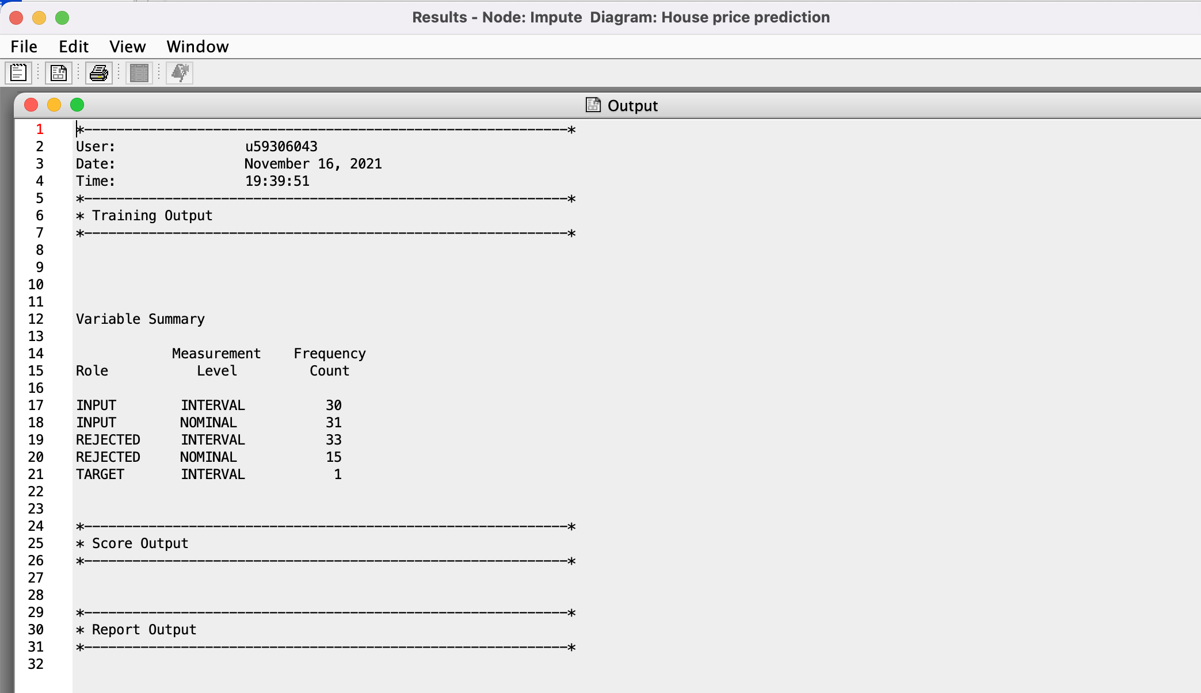
.
Data Partition : The data needs to be split so that we get separate samples for train , test and validation stages of building the model. Here, in our project we give 70% to train and 30% to test data.
The “data partition node” can be used to generate a partition field that splits the available data into individual subsets that can be utilized for training, testing and validation stages in our model building.
Impute Node - to replace missing values in data sets that are used for data mining using mean, median or other imputation method. The imputation technique replaces the missing data with some substitute value to retain most of the data and information present in the dataset. In our project, we have used “median” to impute.

Slide 11
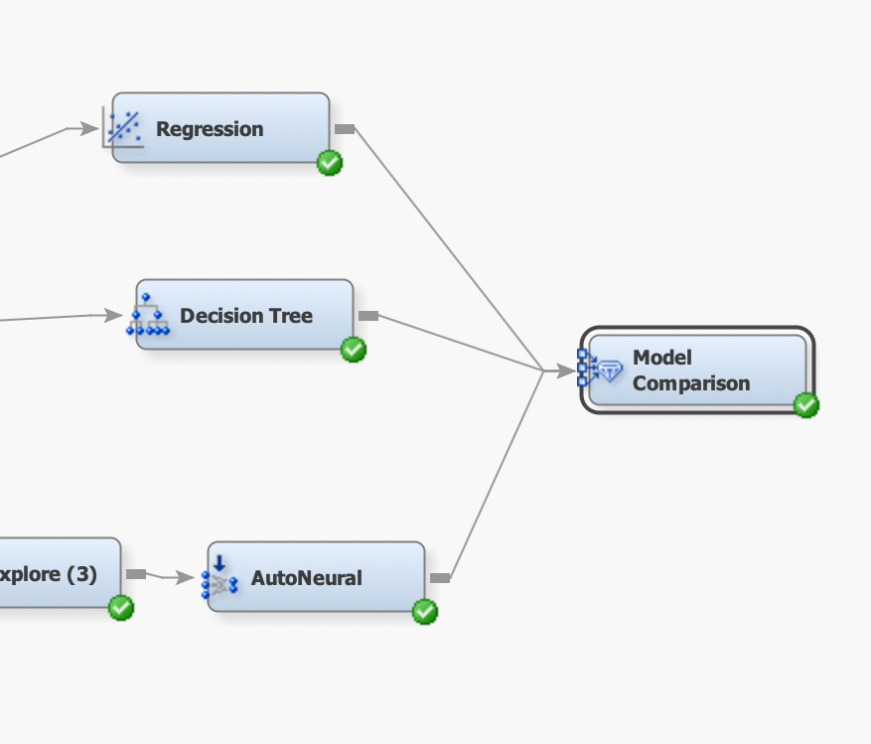
Models Used
We have used 3 models in this project,
Linear Regression
Decision Tree
Auto Neural Networks
For the purpose of determining the best model, We used three models and compared the respective results in determining the efficient model.
Each model has been evaluated using the same dataset input variables, to determine the target variable.
The pros and cons of using different models are considered and model comparison node results are taken into consideration in determining efficient model.

Slide 12
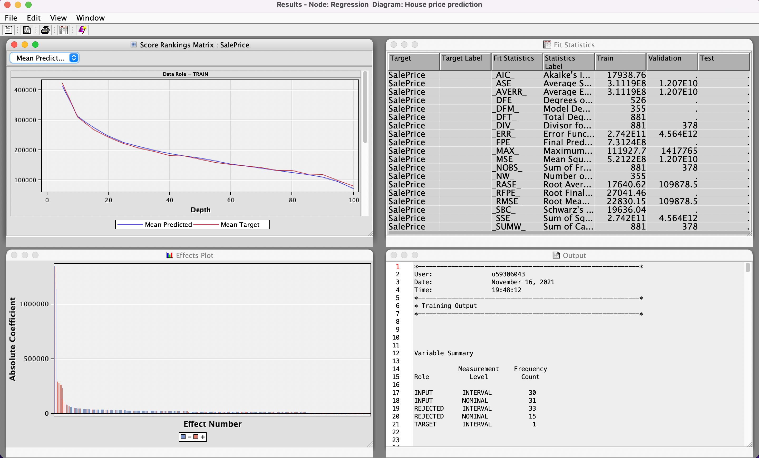
Linear Regression Model
First model which we tested is Linear Regression, which gives us a linear relationship between the input variables (say x) and the target output variable (say y)
Model results for the Regression node are as attached.
The Model significance can be determined by the “f test” associated with the parameters.
The higher the f test value, more likely we can reject the null hypothesis.
We got R-square value as 0.9556 and Adj R-Square value as 0.9257
KitchenQual, Neighborhood, REP_BsmtUnfSF, REP_TotalBsmtSF, REP_OverallQual, REP_OverallCond values are significant.(Pr>F)<.0001

Slide 13
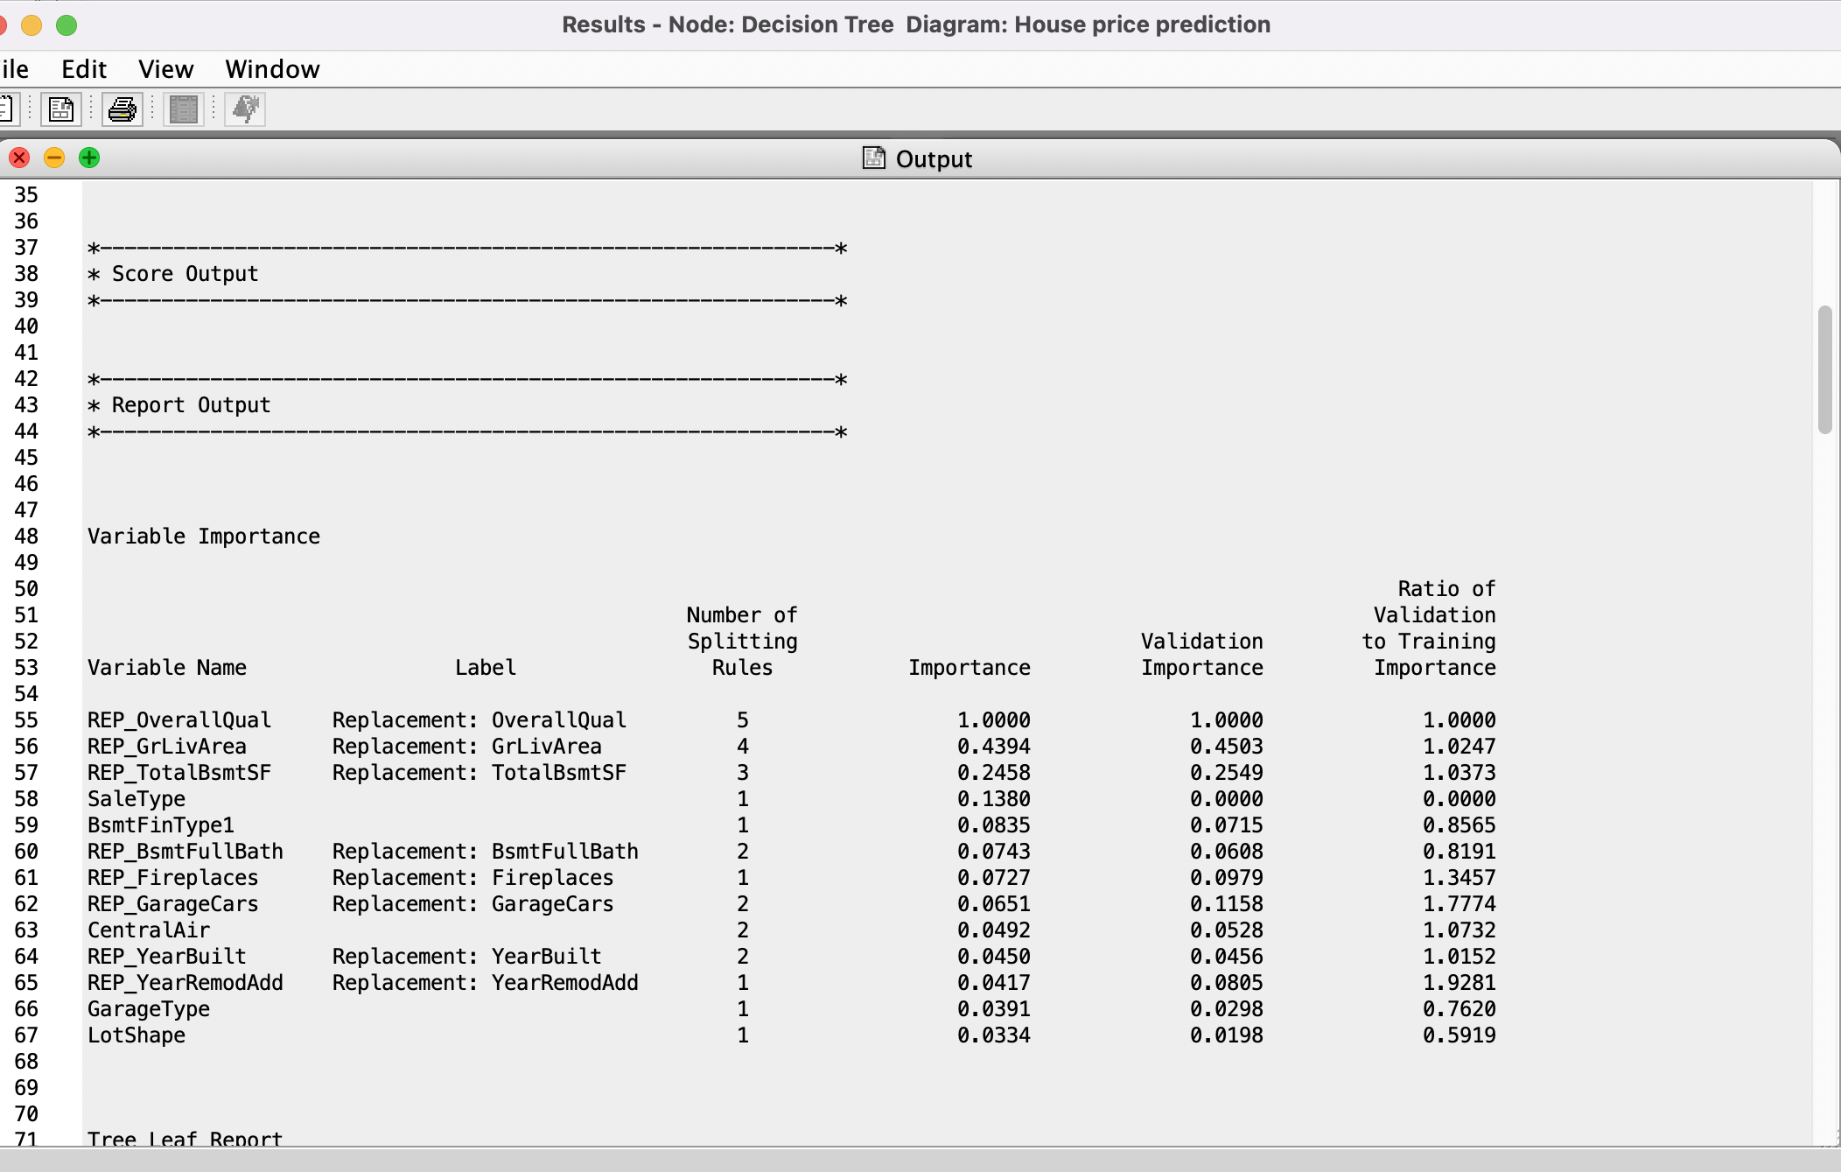
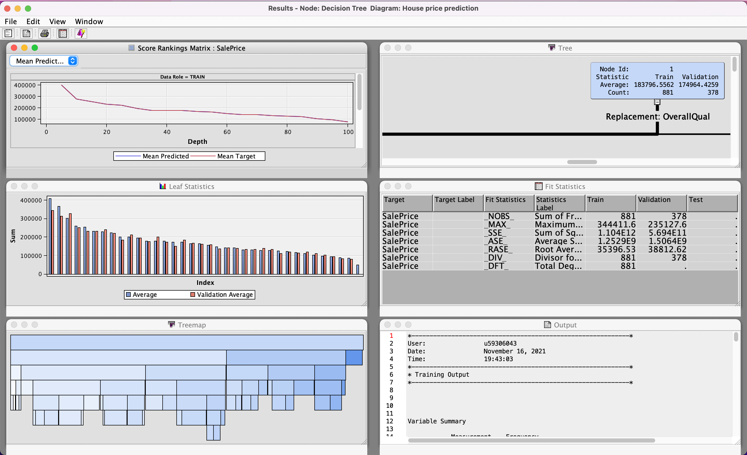
Decision Tree Model
A decision tree creates a hierarchical representation of the input data based on a series of rules applied to each observation. Each rule assigns an observation to a segment based on the value of one predictor which we give. Rules are applied sequentially, which results in a hierarchy of segments within segments.
Decision tree model gives the leaf statistics and the splitted tree diagram. The decision tree results can be observed from the results tab present in the decision tree tab.
The number of leaves in decision tree are 36.( average and validation average), the first spliting decision tree was done by Replacement,Overall.

Slide 14
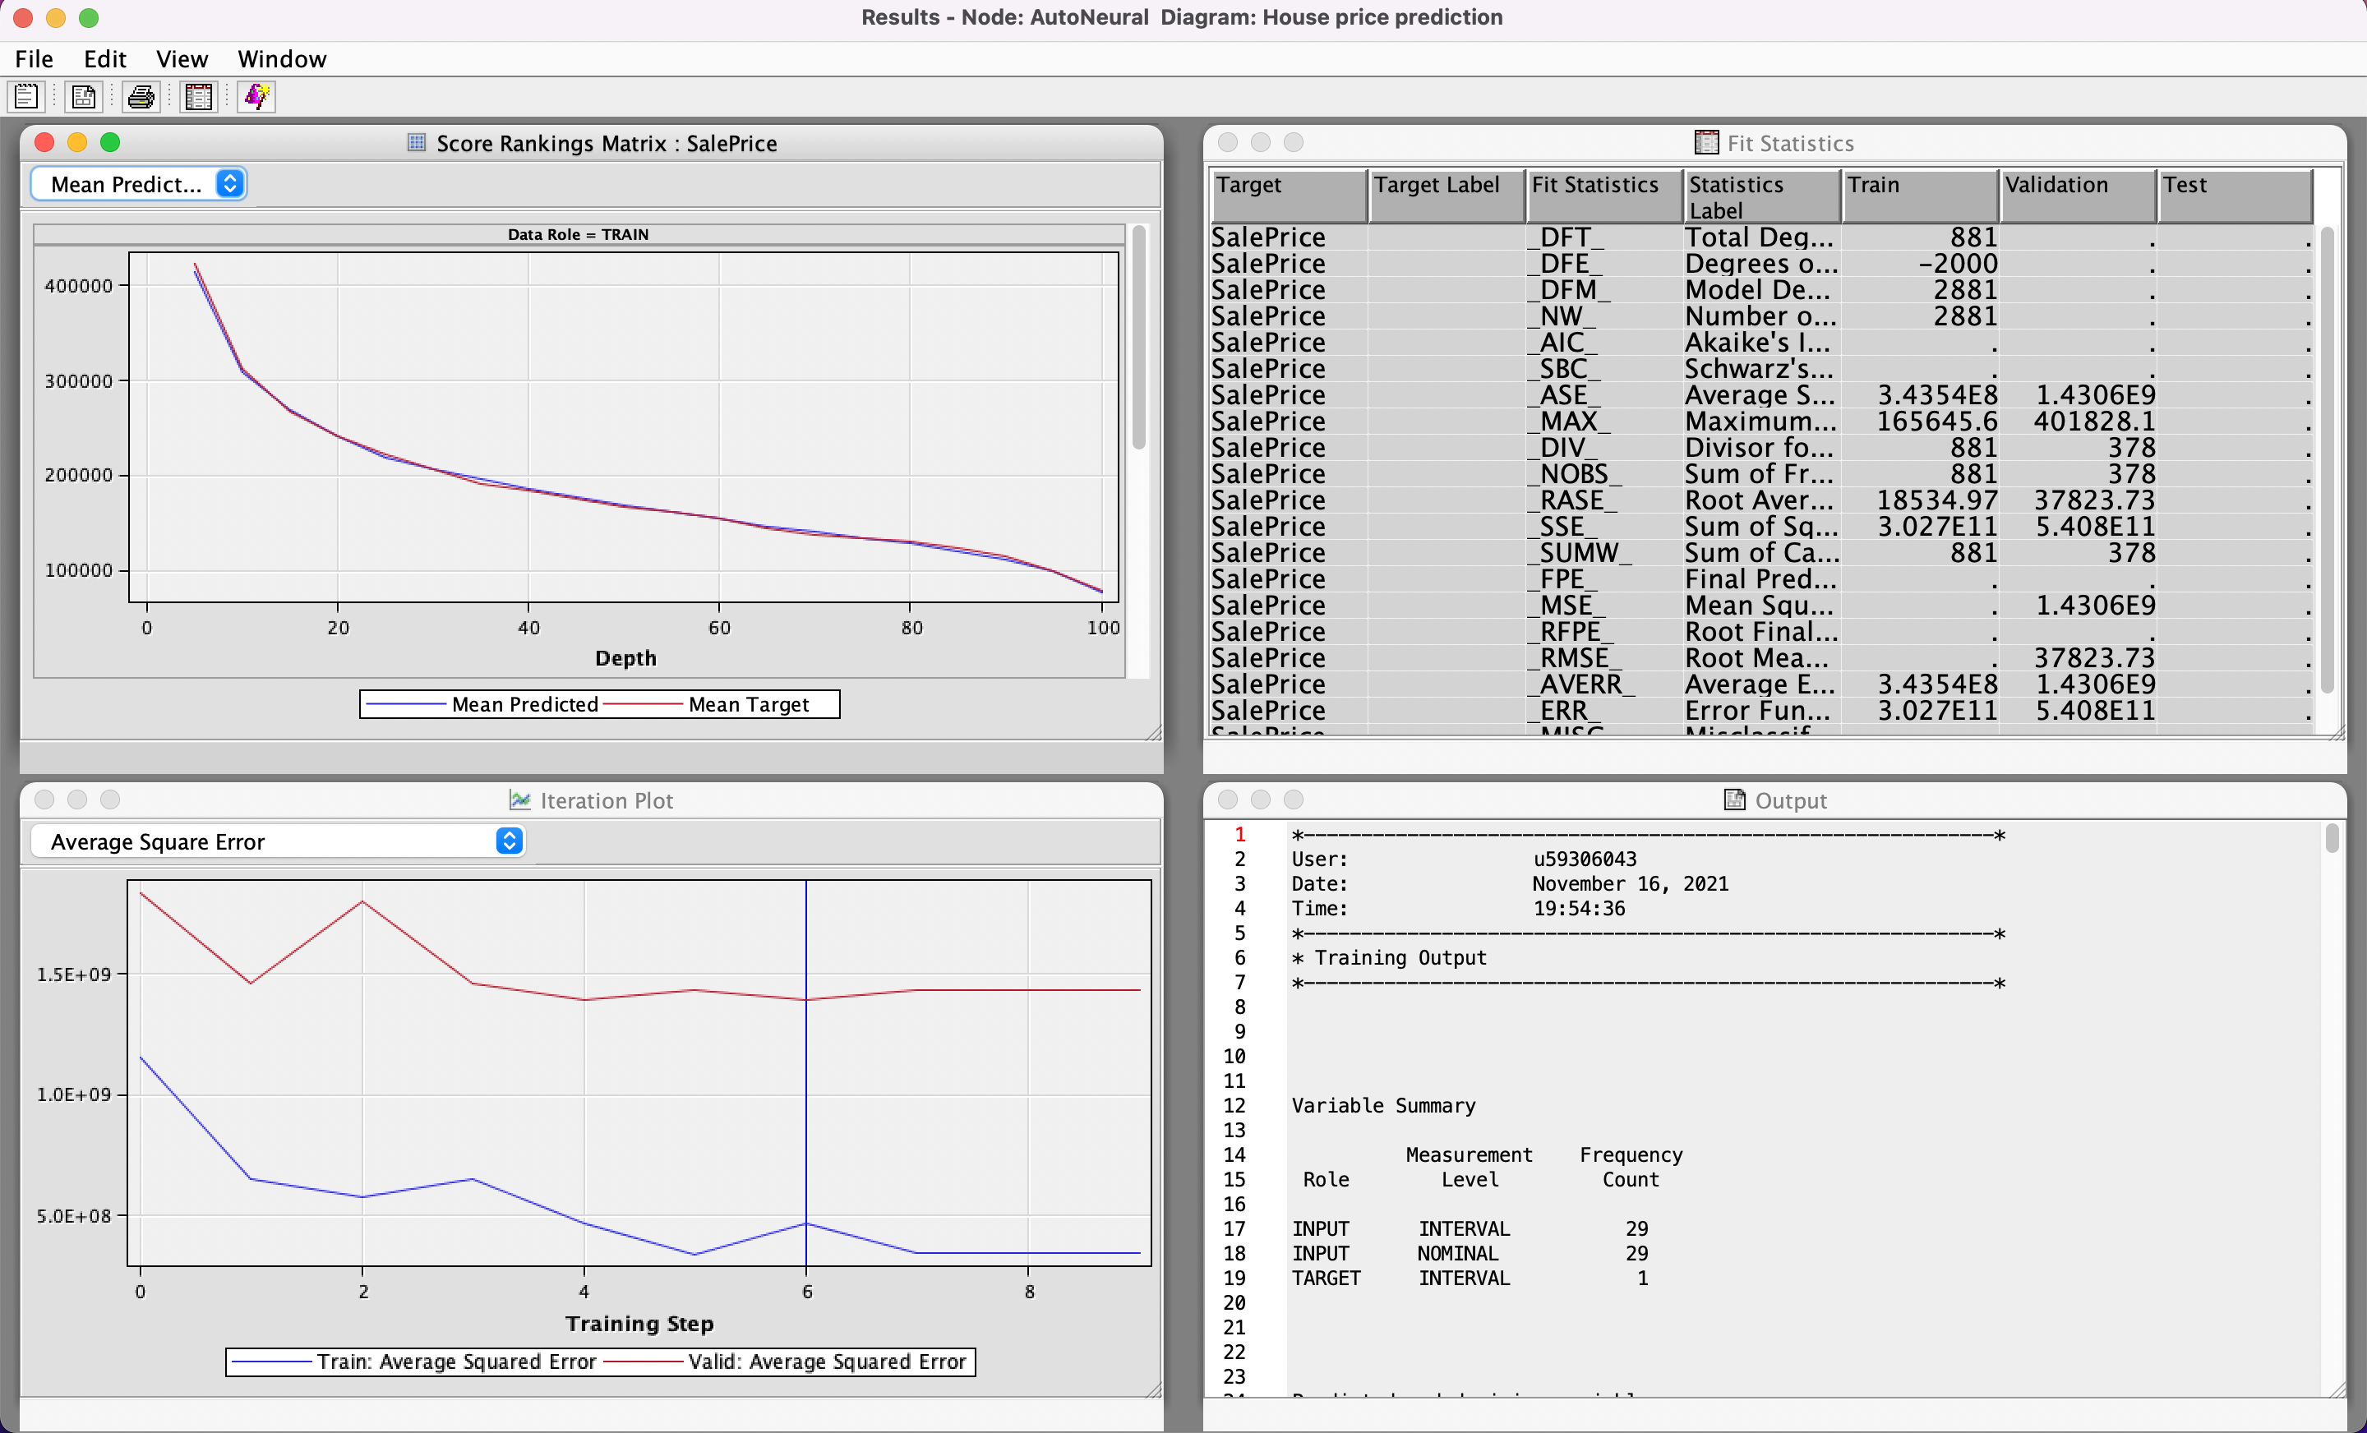
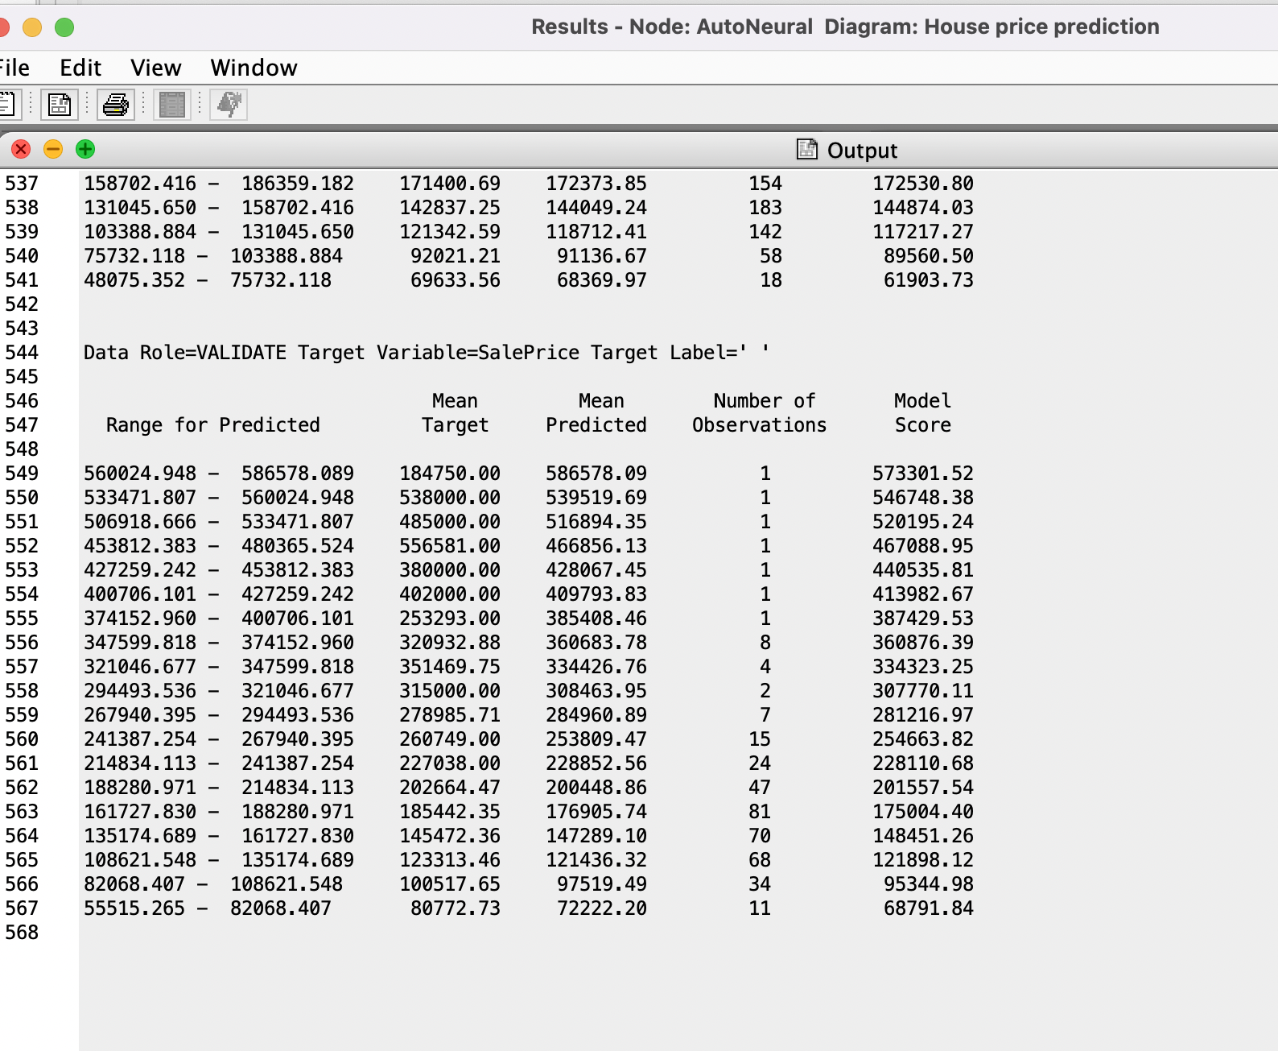
Auto Neural Network
The auto neural node gives us an algorithm for building a multilayer network.
The auto neural node is utilized for analyzing the efficient results. The input is fed with imputed values, the impute node is utilized to replace the missing values with median, although there are a smaller number of missing values after utilizing the replacement node in the initial stage of model.
.

Slide 15
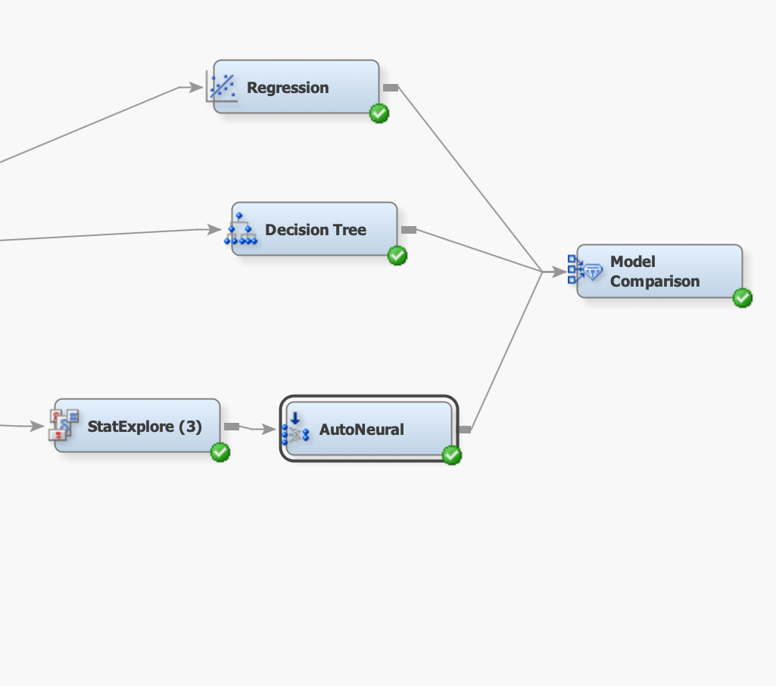
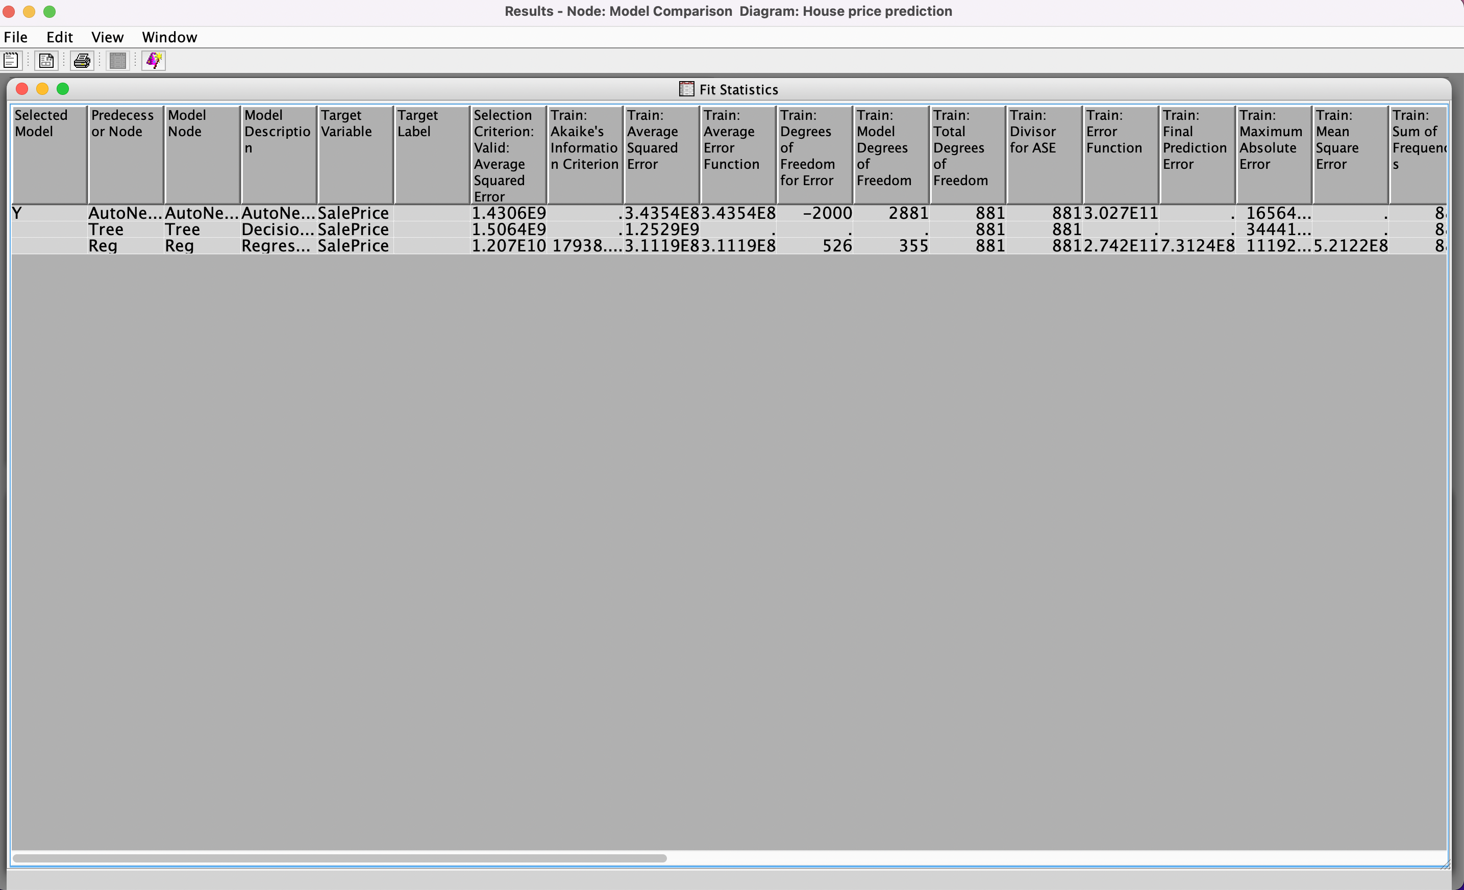
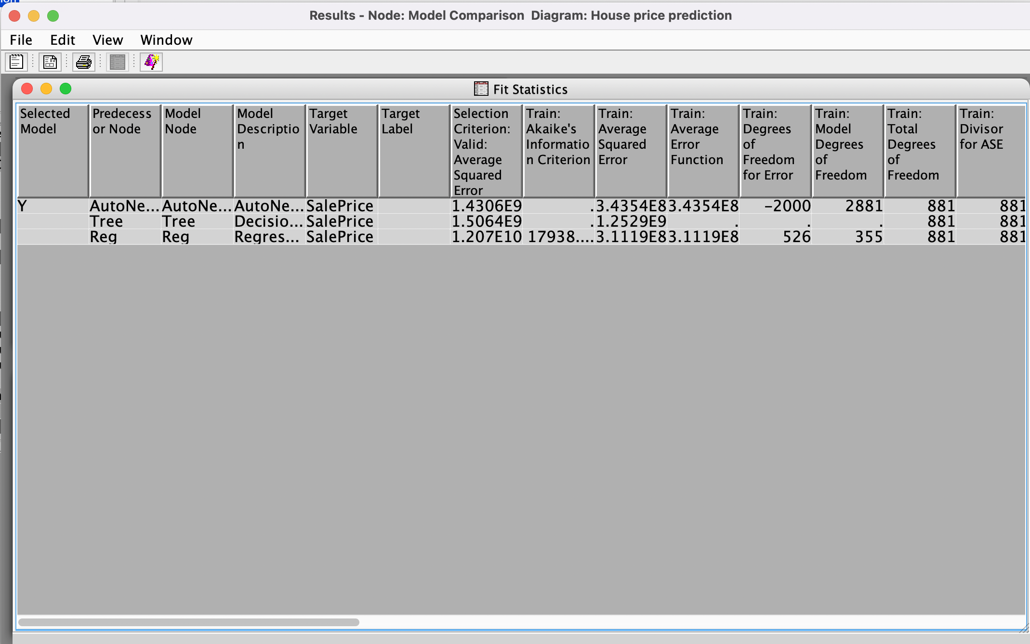
The model comparison node belongs to the assess category. It helps us to compare the performance of competing models which in our cases are Decision tree, Regression model and Auto neural network, with various benchmarking criteria.
Based on the results from the fit statistics, It can be found out that after comparing each model with the help of model comparison node ,It can be observed that the average squared error of auto neural network is less compared to the remaining models .
Hence, it can be found out that the auto neural network is giving better results and the accuracy is higher in the auto neural network results.
Model Comparison
.

Slide 16
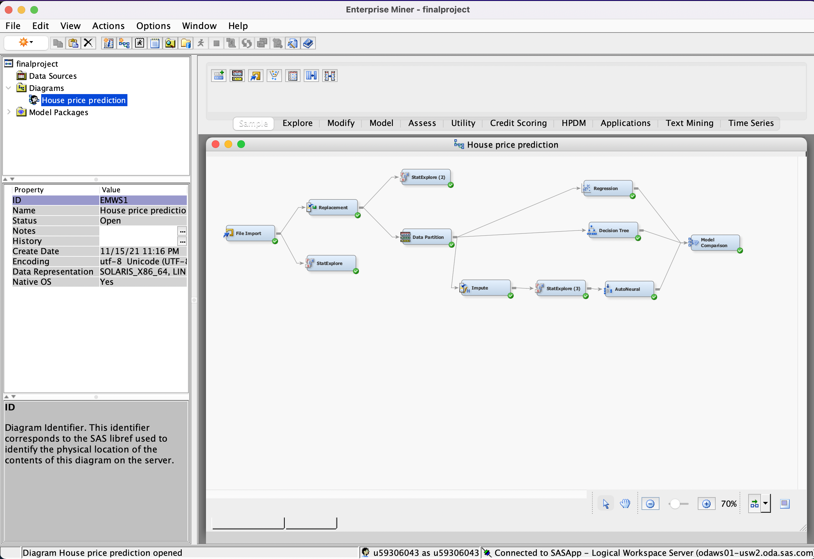
Final SAS Diagram
.

Slide 17
Findings
The "Model Comparison" node allowed us to compare three models which we used to forecast the price of the house to find which model performed the best.
When the results of linear regression and decision trees are compared to the output of the auto neural network, it is discovered that the auto neural network produces more accurate outputs and can be depended on for accurate prediction results.
The target variable “SalePrice” is determined using input variables such as YrSold, YearRemodAdd, and YearBuilt. The multiple models' outputs are evaluated to determine which has the most accurate results for saleprice.
To avoid the error of missing data on the efficient output, replacement and imputation nodes were used.
The model comparison node takes several things into account, resulting in the “Auto neural network model” being the most efficient model when compared to the other models.

Slide 18
Managerial/business implications
Our current project can be utilized in the real time business environment to predict the house prices beforehand which gives a scope for the people willing to invest in buying a house manage their finances in that time- frame.
This project can be helpful for the investment companies to know the trends in the property prices with respect to the location, so that the investors can take wise and appropriate decision according to the predicted demand.
The real estate sector, “Housing Market” efficiency can be improved, and proper planning and use of the available geographical area can be done with the help of the price prediction project.
By considering the various features that affect the house price, the new houses can be built to gain more attention from people increasing the sales.

Slide 19
Conclusions
Based on the prediction outputs, accuracy rate, and efficiency of the three models Linear, Decision and Auto Neural, “Auto neural network" can be used for better prediction of house prices, where sales price is our target variable.
Although regression and decision tree models can be used for prediction, auto neural networks, based on the project's observations, provide superior outcomes with more accuracy.

Slide 20
References
https://www.kaggle.com/c/neolen-house-price-prediction/data?select=test.csv
Y. Feng and K. Jones, ―Comparing multilevel modelling and artificial neural networks in house price prediction,‖ 2015 2nd IEEE Int. Conf. Spat. Data Min. Geogr. Knowl. Serv., pp. 108–114, 2015.
Modeling House Price Prediction using Regression Analysis and Particle Swarm Optimization Case Study: Malang, East Java, Indonesia (IJACSA) International Journal of Advanced Computer Science and Applications, Vol. 8, No. 10, 2017
R. A. Rahadi, S. K. Wiryono, D. P. Koesrindartotoor, and I. B. Syamwil, ―Factors influencing the price of housing in Indonesia,‖ Int. J. Hous. Mark. Anal., vol. 8, no. 2, pp. 169–188, 2015.
V. Limsombunchai, ―House price prediction: Hedonic price model vs. artificial neural network,‖ Am. J. ..., 2004.
https://documentation.sas.com/doc/en/emref/14.3/p1lmg1hmgbpz5cn1cxhmqfucnxlj.htm

